Slide 1
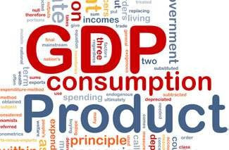
Macroeconomics

Slide 2
Macroeconomics deals with the economy as a whole. It examines the forces that affect many firms, consumers and workers at the same time. It studies the behaviour of economic aggregates such as aggregate income, consumption, investment, and the overall level of prices.

Slide 3


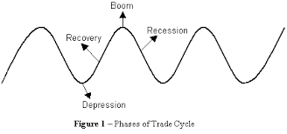
Major Concerns of Macro Economics
Aggregate Demand
Aggregate Supply Saving Inflation/Deflation Economic growth Unemployment Trade Cycle

Slide 4
Importance of Macro Economics
It explains the working of the economy as a whole.
It examines the aggregate behaviour of Macro Economics entities like firms, households and the government.
It is very useful to the planner for preparing economic plans for the country's development.
It is helpful in international comparison.

Slide 5

KEY CONCEPTS OF MACROECONOMICS
1930s marked the first stirrings of the science of macroeconomics, founded by John Maynard Keynes as he tried to understand the economic mechanism that produced the Great Depression.
John Maynard Keynes, was an English economist, whose ideas fundamentally changed the theory and practice of macroeconomics and the economic policies of governments.

Slide 6
Enacted the landmark Employment Act of 1946.
Government’s role in promoting output growth, fostering employment and maintaining price stability.

Slide 7
Central Macroeconomic questions:
Why do output and employment sometimes fall, and how can unemployment be reduced?
What are the sources of price inflation, and how can it be kept under control?
How can a nation increase its rate of economic growth?

Slide 8
Objectives and Instruments of Macroeconomics
Objectives | Instruments
Output | Monetary Policy
Employment | Fiscal Policy
Price-level stability

Slide 9
Aggregate Supply and Aggregate Demand
Aggregate Supply - Aggregate supply is the total quantity of output firms will produce and sell—in other words, the real GDP.
The upward-sloping aggregate supply curve—also known as the short run aggregate supply curve—shows the positive relationship between price level and real GDP in the short run.

Slide 10
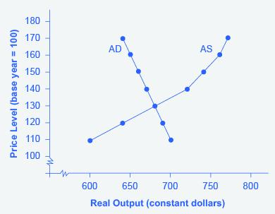
Aggregate demand is the amount of total spending on domestic goods and services in an economy.
The downward-sloping aggregate demand curve shows the relationship between the price level for outputs and the quantity of total spending in the economy.

Slide 11
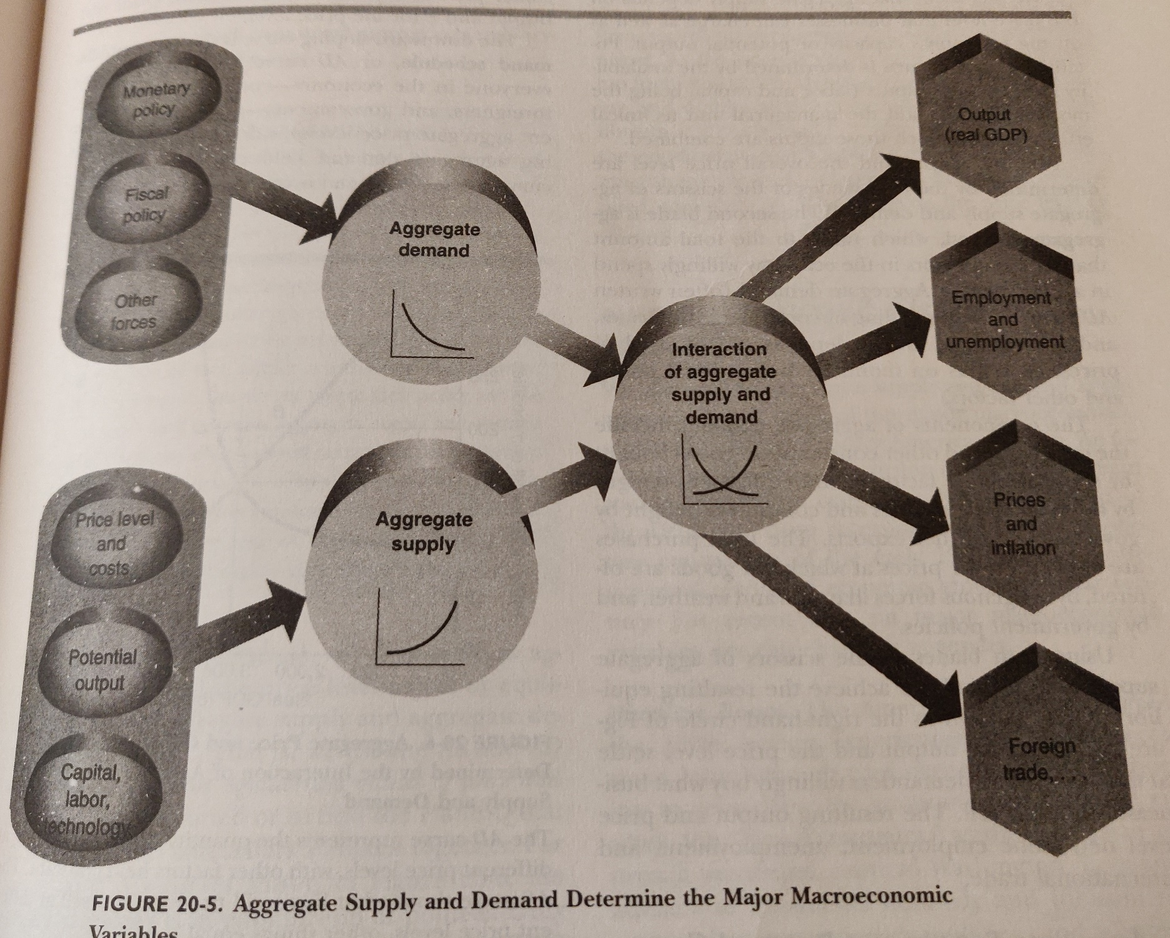

Slide 12
National Income Terms

Slide 13
What is National Income?
National income measures the total value of goods and services produced within the economy over a period of time.
National Income can be denoted in different ways with different meaning attached to it.
Gross Domestic Product (GDP)
Gross National product (GNP)

Slide 14
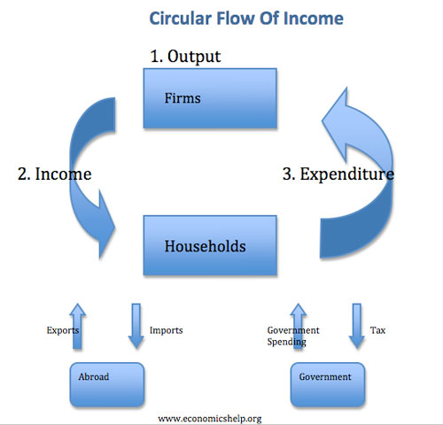
Gross Domestic Product (GDP)
GDP measures the value of output produced within the domestic boundaries of the country
GDP includes the output of the foreign owned firms with production plants located in the country
There are three ways of calculating GDP - all of which should sum to the same amount since by identity:
National Output = National Expenditure = National Income

Slide 15
Example: Pricing of one pen Rs. 20/-
Value for one pen = Rs. 20/-
(National output)
A customer purchases one pen = Rs. 20/-
(National expenditure)
The shopkeeper sells one pen = Rs. 20/-
(National income)

Slide 16
Product (or Output) Method
Product method is also called Value Added Method or Industrial Origin Method
The market value of all the goods and services produced in the country by all the firms across all industries are added up together.

Slide 17
Income Method
The income approach calculates the income earned by all the factors of production in an economy, including the wages paid to labor, the rent earned by land, the return on capital in the form of interest, and corporate profits.

Slide 18
Expenditure method
Expenditure or outlay on final products takes place in three ways
Expenditure by consumers on goods and services( Consumption Expenditure)
Expenditure by entrepreneurs on capital or investment goods (Investment Expenditure)
Expenditure by government on consumption and
capital goods (Government Expenditure)
Net Exports
18

Slide 19
Expenditure method
The formula for this method is
Y = C + I + G +(X-M)
Here Y stands for total expenditure
C stands for consumption expenditure
I stands for investment expenditure
G stands for Government expenditure
(X-M) Difference between exports and imports
19

Slide 20
Components of National Income

Slide 21
The Components of GDP
Y = C + I + G + NX
Total demand
for domestic
output (GDP)
Investment
spending by
businesses
is composed
of
Net exports
or net foreign
demand
Consumption
spending by
households
Government
purchases of goods
and services

Slide 22
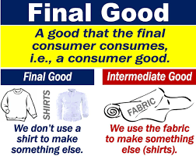
GDP only includes final products — goods for sale, rather than intermediate goods that are used to make final products. So a raw fish sold to a customer at a supermarket is part of GDP, but a raw fish sold to a restaurant isn’t — only the cooked fish the restaurant sells to its customers counts. This is to avoid double-counting.

Slide 23
Think about a dress as an example. GDP only counts the total value of the dress that’s eventually sold.
Selling price of the dress = Rs. 1000/-
Selling price = Cost + profit
= Rs. 600 + 400
Cost = cost of raw material + stitching charge+ other material required
= Rs. 200 + 300 + 100
Therefore cost = Rs. 600/-
Profit = Rs. 400/-

Slide 24
Calculating GDP
= P*Q(material) + P* Q (stitching charges) +
P * Q (other material) + P * Q(dress)
= Rs. 200 + Rs. 300 + Rs. 100 + Rs. 1000
(200+300+100)
This is the problem of double counting. Therefore we do not include intermediate goods while calculating GDP.

Slide 25
C (consumption) is normally the largest GDP component in the economy, consisting of private expenditures in the economy (household final consumption expenditure). These personal expenditures fall under one of the following categories: durable goods, nondurable goods, and services. Examples include food, rent, jewellery, gasoline, and medical expenses, but not the purchase of new housing.

Slide 26
I (investment) includes, for instance, business investment in equipment, but does not include exchanges of existing assets. Examples include construction of a new mine, purchase of software, or purchase of machinery and equipment for a factory.

Slide 27
Buying financial products is classed as ‘saving’, as opposed to investment. This avoids double-counting: if one buys shares in a company, and the company uses the money received to buy plant, equipment, etc., the amount will be counted toward GDP when the company spends the money on those things; to also count it when one gives it to the company would be to count two times an amount that only corresponds to one group of products. Buying bonds or stocks is a swapping of deeds, a transfer of claims on future production, not directly an expenditure on products.

Slide 28
G (government spending) is the sum of government expenditures on final goods and services. It includes purchases of weapons for the military and any investment expenditure by a government. It does not include any transfer payments, such as social security or unemployment benefits.

Slide 29
X (exports) represents gross exports. GDP captures the amount a country produces, including goods and services produced for other nations' consumption, therefore exports are added.
M (imports) represents gross imports. Imports are subtracted since imported goods will be included in the terms G, I, or C, and must be deducted to avoid counting foreign supply as domestic.

Slide 30
GROSS NATIONAL PRODUCT (GNP)
Gross national product (GNP) is an estimate of total value of all the final products and services turned out in a given period by the means of production owned by a country's residents.
GNP is commonly calculated by taking the sum of personal consumption expenditures, private domestic investment, government expenditure, net exports and any income earned by residents from overseas investments, minus income earned within the domestic economy by foreign residents.
Net exports represent the difference between what a country exports minus any imports of goods and services.
﻿

Slide 31
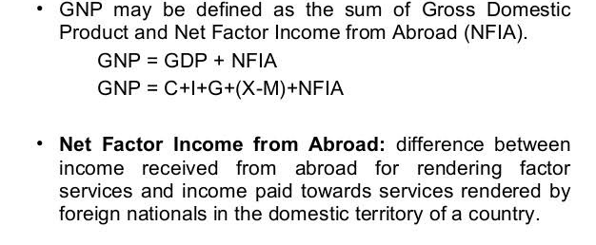

Slide 32
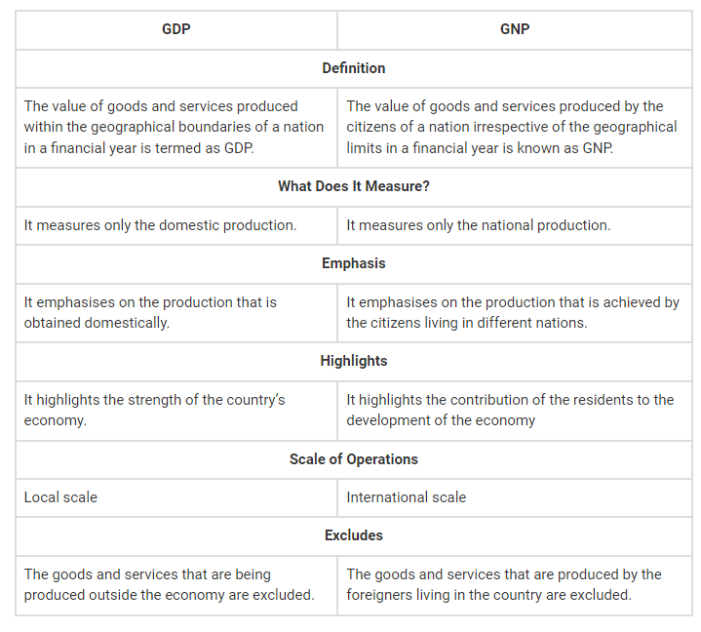
GDP | GNP
Definition
The value of goods and services produced within the geographical boundaries of a nation in a financial year is termed as GDP. | The value of goods and services produced by the citizens of a nation irrespective of the geographical limits in a financial year is known as GNP.
What Does It Measure?
It measures only the domestic production. | It measures only the national production.
Emphasis
It emphasises on the production that is obtained domestically. | It emphasises on the production that is achieved by the citizens living in different nations.
Highlights
It highlights the strength of the country’s economy. | It highlights the contribution of the residents to the development of the economy
Scale of Operations
Local scale | International scale
Excludes
The goods and services that are being produced outside the economy are excluded. | The goods and services that are produced by the foreigners living in the country are excluded.

Slide 33
REAL AND NOMINAL GDP

Slide 34
Example
Year | Price of a Product A (in Rs.) | Quantity of Product A (in units)
2014 | 100 | 50
2015 | 120 | 60
2016 | 130 | 70
Year | Price of a Product B(in Rs.) | Quantity of Product B (in units)
2014 | 40 | 30
2015 | 50 | 40
2016 | 60 | 50

Slide 35
Case 1
GDP for the year 2014
= (100*50) + (40*30)
= Rs. 6,200/-
GDP for the year 2015
= (120*60) + (50*40)
= Rs. 9,200/-
GDP for the year 2016
= (130*70) + (60*50)
= Rs. 12,100/-

Slide 36
Case 2
(assume 2014 as base year)
GDP for the year 2014
= (100*50) + (40*30)
= Rs. 6,200/-
GDP for the year 2015
= (100*60) + (40*40)
= Rs. 7,600/-
GDP for the year 2016
= (100*70) + (40*50)
= Rs. 9,000/-

Slide 37
Nominal GDP is an assessment of economic production in an economy but includes the current prices of goods and services in its calculation. (CASE 1)
Real gross domestic product (GDP) is an inflation-adjusted measure that reflects the value of all goods and services produced by an economy in a given year, expressed in base-year prices, and is often referred to as "constant-price," "inflation-corrected" GDP, or "constant dollar GDP."
i.e Real GDP uses constant base year prices for calculations. (CASE 2).
Base year is a reference year.

Slide 38
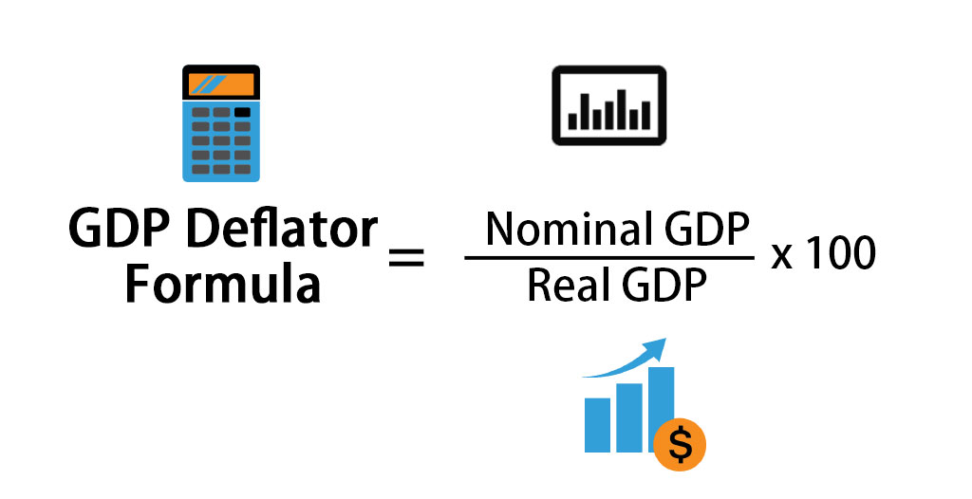
GDP DEFLATOR
This is a measure of the level of prices of all new, domestically produced, final goods and services in an economy.

Slide 39
GDP deflator calculations using the nominal and real GDP calculations (refer previous example)
GDP deflator for the year 2014
= Nominal GDP (2014) * 100
Real GDP (2014)
= 100
GDP deflator for the year 2015
= Nominal GDP (2015) * 100
Real GDP (2015)
= 121.05

Slide 40
Using GDP deflator to calculate inflation
Rate of Inflation (ROI for the year 2015)
= GDP Def (current) − GDP Def (previous) × 100
GDP Def (previous)
= 121.06 − 100 × 100
100
= 21.06 %

Slide 41
What Are Some Problems with the GDP?
1.) Doesn't measure how the goods are distributed to the population
2.) Doesn't include unpaid household work
3.) Doesn't measure the quality of items produced
4.) GDP counts remedial and defensive expenditures (such as the costs of security, police, pollution clean up, etc.) as positive contributions to commerce.

Slide 42
INFLATION
Inflation is a quantitative measure of the rate at which the average price level of a basket of selected goods and services in an economy increases over some period of time.
It is the rise in the general level of prices where a unit of currency effectively buys less than it did in prior periods.

Slide 43
Inflation has an impact on the cost of living and the development of the economy as a whole. Starting from there, we can identify two broad types of inflation: cost-push inflation and demand-pull inflation. We will look at each of them in more detail below.

Slide 44
1. Demand-pull inflation results from an excess of aggregate demand relative to aggregate supply.
For example, consider a popular product where demand for the product outstrips supply. The price of the product would increase. The theory in demand-pull inflation is if aggregate demand exceeds aggregate supply, prices will increase economy-wide.

Slide 45
Cost-push inflation results from general increases in the costs of the factors of production.
These factors—which include capital, land, labor, and entrepreneurship—are the necessary inputs required to produce goods and services.
When the cost of these factors rise, producers wishing to retain their profit margins must increase the price of their goods and services. When these production costs rise on an economy-wide level, it can lead to increased consumer prices throughout the whole economy, as producers pass on their increased costs to consumers.

Slide 46
Example
Price of a chair = Rs. 1000/-
= Rs. 700 + 300
Now say the cost of wood increases hence cost of crafting the chair increases from Rs. 700 to Rs. 900
Now the seller has two options:
Keep the initial price the same i.e Rs. 1000/-
if this happens the profit will have to be to be reduced from Rs. 300/- to Rs. 100/-.
2. Keep the profit the same as Rs. 300/-
In this case the price of the chair increases from Rs. 1000 to Rs. 1,200/-

Slide 47
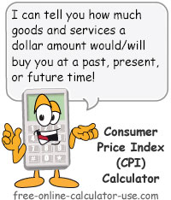
Consumer Price Index (CPI)
A Consumer Price Index measures changes in the price level of a weighted average market basket of consumer goods and services purchased by households.

Slide 48
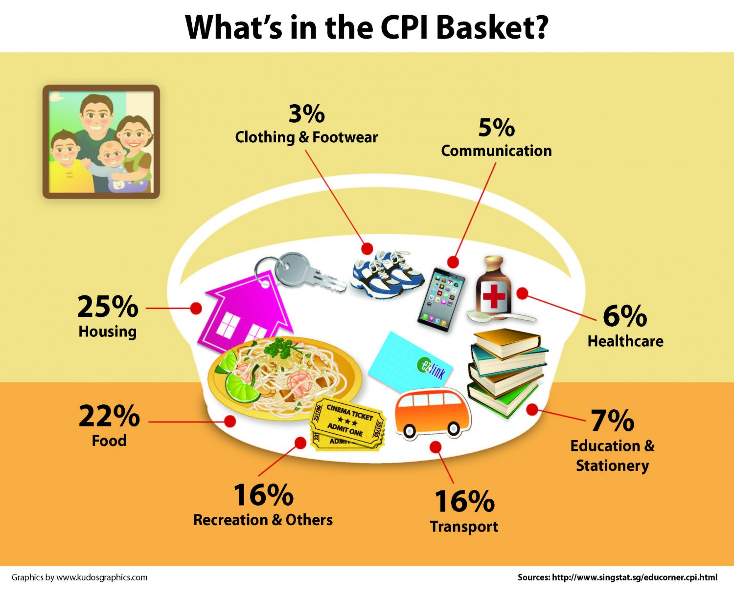

Slide 49
Steps to calculate inflation using CPI
1. Select the basket of goods and services
2. Select the base year (reference year)
3. Check prices in the current and value the basket at the current year prices
4. Check prices in the base year and value the basket at the base year prices
5. Find the index for the current year and the base year for each item
Current year Index = (Current year price / base year price) * 100

Slide 50
6. Find CPI
CPI = Sum of all current year index
7. Find the Rate of Inflation (ROI)
= CPI (current year) - CPI (Base Year) * 100
Number of items
CPI (base year)

Slide 51
ITEM | Year 2012 (1) | Year 2018 – 2 | INDEX (2/1)*100
Food | 150 | 240 | = 240/150*100 = 160
Apparel | 300 | 420 | = 420/300*100 = 140
Medical Care | 250 | 200 | = 200/250*100 = 80
Transportation | 160 | 180 | = 180/160*100 = 112.5
Assume 2012 as base year
Assume 2018 as current year
Find the index for the current year 2018

Slide 52
Simple CPI (for the year 2018)
= Sum of all current year index
= 492.5/4
= 123.1
Number of items

Slide 53
ITEM | Year 2012 (1) | Year 2018 (2) | INDEX (1/1)*100
Food | 150 | 240 | = 150/150*100 = 100
Apparel | 300 | 420 | = 300/300*100 = 100
Medical Care | 250 | 200 | = 250/250*100 = 100
Transportation | 160 | 180 | = 160/160*100 = 100
Assume 2012 as base year
Find the index for the year 2012

Slide 54
Simple CPI (for the year 2012)
= Sum of all current year index
= 400/4
= 100
NOTE: The base year index is equal to 100.
Number of items

Slide 55
Rate of Inflation (ROI)
= CPI (current year) - CPI (Base Year) * 100
= (123.1 – 100) * 100
= 23.1 %
Therefore the general price level or costs have increased by 23.1 percent from the base year to the current year.
CPI (base year)
100

Slide 56
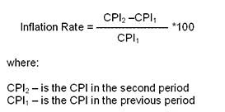

Slide 57
Net Domestic Product and Net National Product
Net Domestic Product = GDP-Depreciation
Net National Product (NNP) = GDP – Depreciation +NFIA
Or
= GNP–Depreciation
= C+I+G+(X–M)–Depreciation + NFIA

Slide 58
Per Capital Income and Personal Income
Per capita income is the average income of the people of a country in a particular
year.
Per Capita Income = ^{National Income}
Total Population
Personal income is the total income received by the individuals of a country from all sources in one year.
Personal Disposable Income is the income which can be spent on consumption by individuals and families.
Notes:
https://groww.in/blog/how-is-per-capita-income-calculated

Slide 59
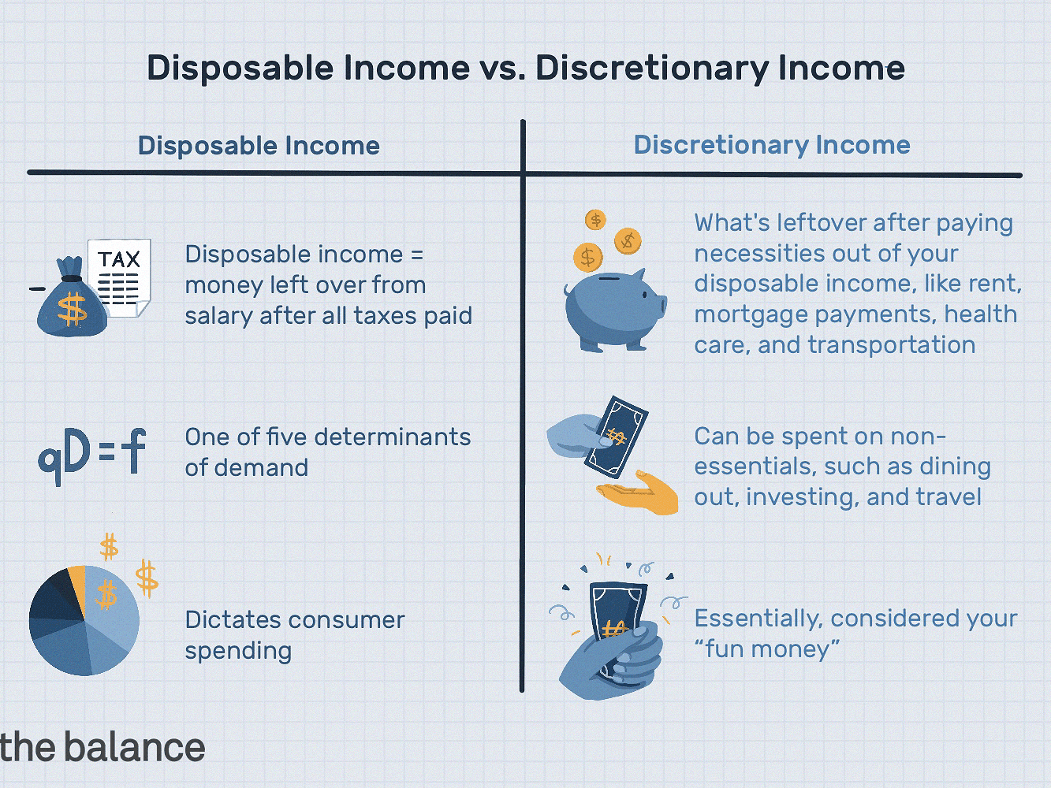

Slide 60
GDP and Economic Well-Being
GDP is the best single measure of the economic well-being of a society.
GDP per person tells us the income and expenditure of the average person in the economy.
Higher GDP per person indicates a higher standard of living.
GDP is not a perfect measure of the happiness or quality of life, however.

Slide 61
Some things that contribute to well-being are not included in GDP.
The value of leisure.
The value of a clean environment.
The value of almost all activity that takes place outside of markets, such as the value of the time parents spend with their children and the value of volunteer work.

